Slide 1
NetBox in a Cloud-Native Environment
Moh Ahmed
May 19th, 2020
Notes:
https://www.linkedin.com/in/mohahmed613/
@moh on NetworkToCode Slack

Slide 2
Agenda
Use Case Context
Cloud-Native Overview
Operating NetBox
NetBox Automation

Slide 3

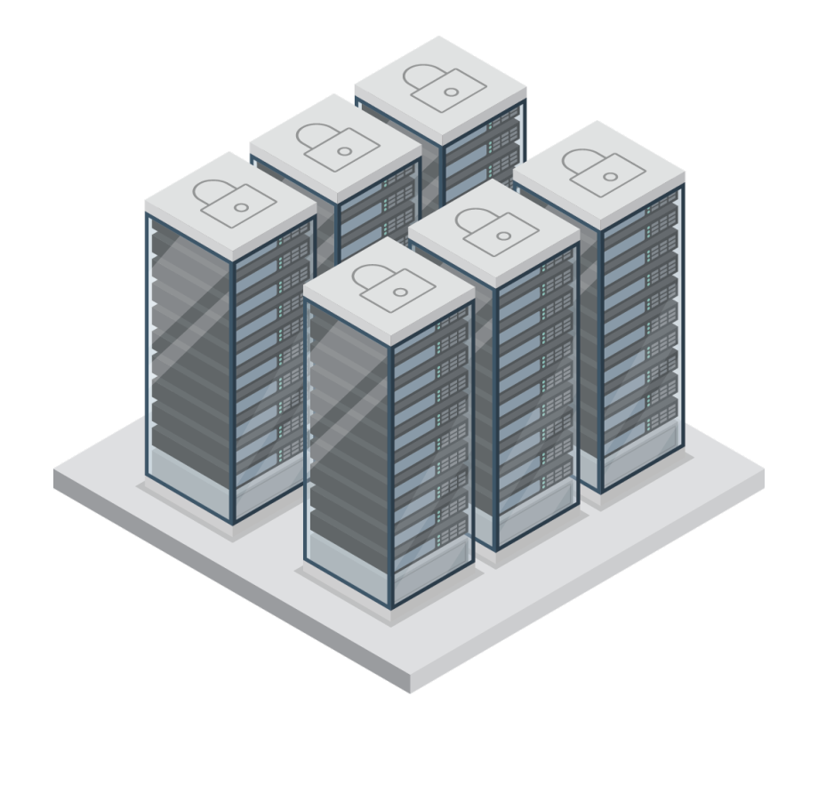

Use Case Context
<10 sites
10’s of tenants and virtual clusters
100’s of racks, device types
1000’s of
Devices, cables, interfaces
Inventory components
Secrets, IP addresses, VLANs
High-Speed
Cloud Native
Virtualized
SDN/NFVI
Multi-Site
Multi-Vendor
Multi-Cloud
Public
Cloud
Security
Automated
Programmable
Notes:
CENGN is a non-for-profit organization working with small and medium businesses in Canada to innovate and grow the ICT sector
We offer IaaS solutions to our customers for testing, validation, and other types of projects targeting the growth of their products
NetBox is used to track our DC and IP inventory so we know what’s deployed remotely and on-site and how they are connected
The scale of the data that we track can be seen above

Slide 4
Cloud-Native Overview
Scalable and modular
Lightweight and quick
Convenient and portable
“Build once, run anywhere”
Deployment consistency
https://github.com/netbox-community/netbox-docker
Notes:
Microservice Architecture: break a complex application into its components, have a container for the database, the front end and the backend. This allows modularity in development, things can be modified in one container and not affect the other containers
Where virtual machines can be gigabytes in size with an OS, containers are usually within the megabytes range
Containers also require less resources in general to run as they don’t need resources for a complete OS
Since there is no OS to boot up, containers can start up incredibly fast, usually close to the time it takes for the app within the container to start
There are endless times where small variations in different environments affect how a piece of software performs on different systems
Item developed for Debian might not work on RedHat Enterprise Linux.
Software built with a package of a certain version may break when there is an update
Containers “contain” the application and all the dependencies/libraries required for the application to run. This means that in theory it can be brought into any container environment running on any system, allowing them to be deployed consistently every time
The Open Containers Initiative was a standard that was introduced to allow for interoperability and accessibility across various platforms and cloud providers
Docker is the most popular implementation of containers, there are others like CRI-O and RKT
Docker created docker hub, the “app store” of containers
We use the community image of NetBox to run the NetBox application in our production and dev environments
A good reference for containers and its terminology: https://developers.redhat.com/blog/2018/02/22/container-terminology-practical-introduction/

Slide 5
Cloud-Native Overview
Kubernetes, the defacto standard
“Governor”, “helmsman”, “captain”, “pilot”
Powerful container orchestration platform
Automated rollouts and rollbacks
Self-healing
Horizontal scaling
Much more
Notes:
In order to manage all the different containers and micro-services deployed in an environment, an orchestration tool is used
Kubernetes has become the defacto standard for container orchestraton
Project website: https://kubernetes.io/ - open source project
Greek for governor or helmsman
Google Borg was Google’s containerized application orchestrator
Some of the same engineers that worked on Borg learned a lot of important things from Google’s large-scale environment

Slide 6

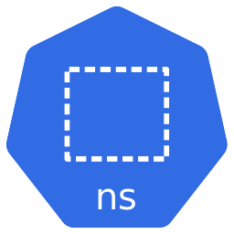
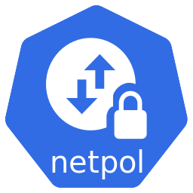
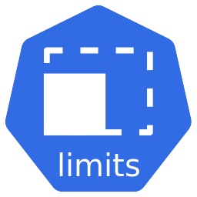
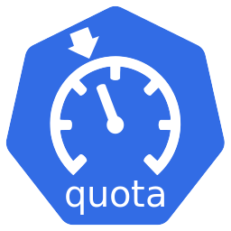
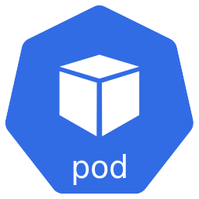
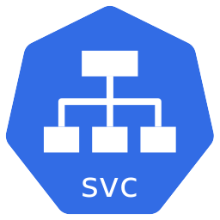
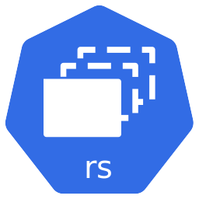
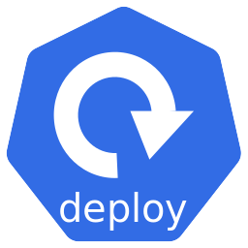
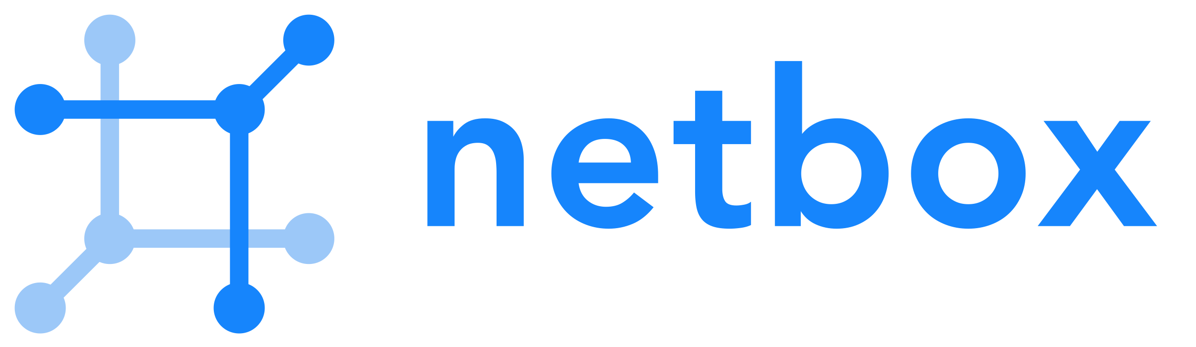
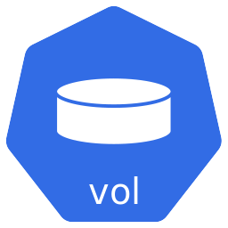
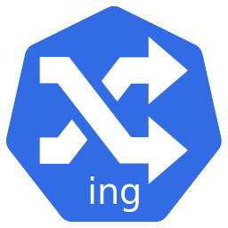
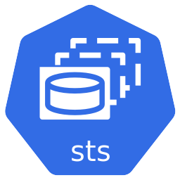
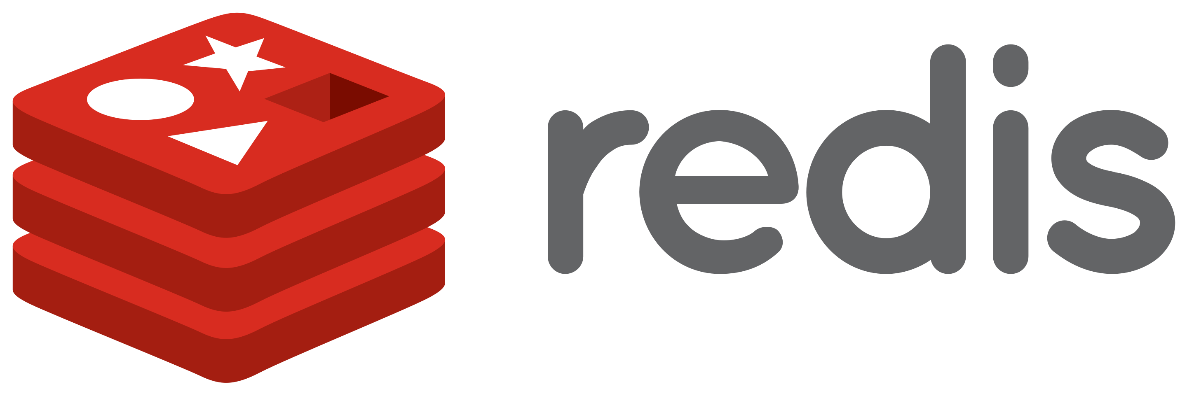
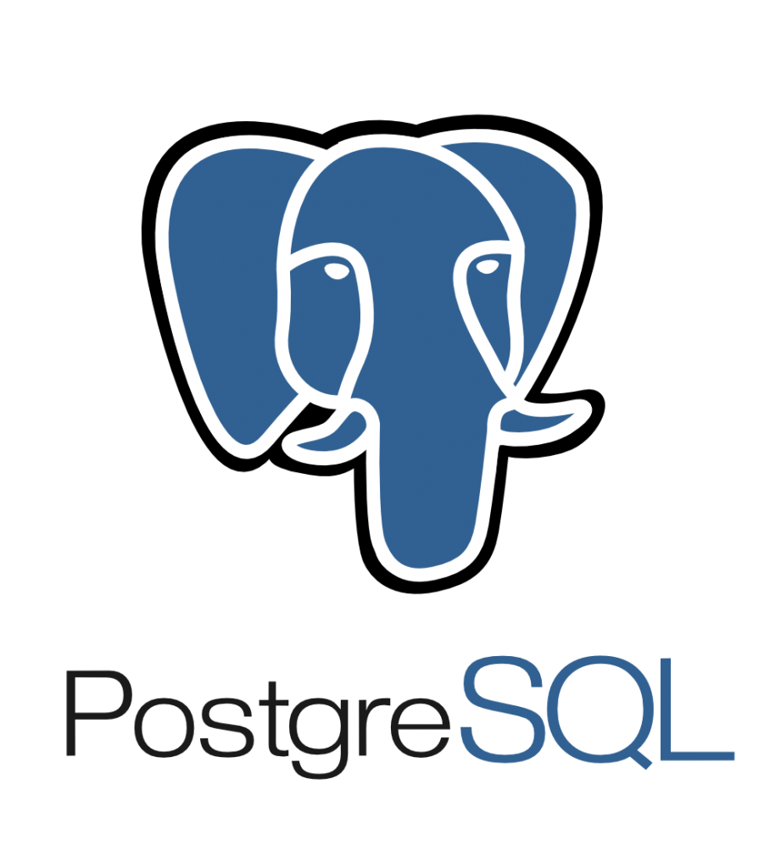
netbox.cengn.ca
Notes:
Sample manifests: https://github.com/CENGN/netbox-kubernetes
Let’s breakdown the deployment:
Our Kubernetes cluster is a collection of compute and storage nodes that make up our control and data plane
Master and worker labels differentiate the two
It has many components (scheduler, KV-store, etc…)
Then we have the namespace resource, a logical separator between resources
We can apply various types of restrictions on a namespace or application:
Network policies to block traffic and lock things down
Resource limits allows us to restrict the cost of running these microservices – think compute costs in a public cloud setting
Quota/requests is what the container is guaranteed to get from the nodes running the workload
Within the netbox namespace, we apply the NetBox container
We apply it through a Deployment resource that specifies the container image, volume mounts, and other metadata information
This spawns a ReplicaSet – think of it as a thermometer which guarantees that a certain number of replicas or duplicates of the application exists
Pods, the base unit of workloads in K8s, are spawned to run the application
A volume is mounted to the pod for persistent data. Different types of volumes exist but in our case, we’re using the Ceph Shared Filesystem
We then have a service that points to the Pods. This creates endpoints to the pods and automatically updates when pods restart
We also have a redis deployment that uses a StatefulSet (sts) which is similar to a deployment but is used for stateful applications. This is configured differently in our case using a master/slave architecture that provides some level of redundancy
Each of the pods get their own volumes
A Service is created for it as well
Inter-application communication happens over the service resource
Similarily, the PostgreSQL service and components are deployed
Finally, in order to actually access the NetBox service, an Ingress resource is deployed

Slide 7
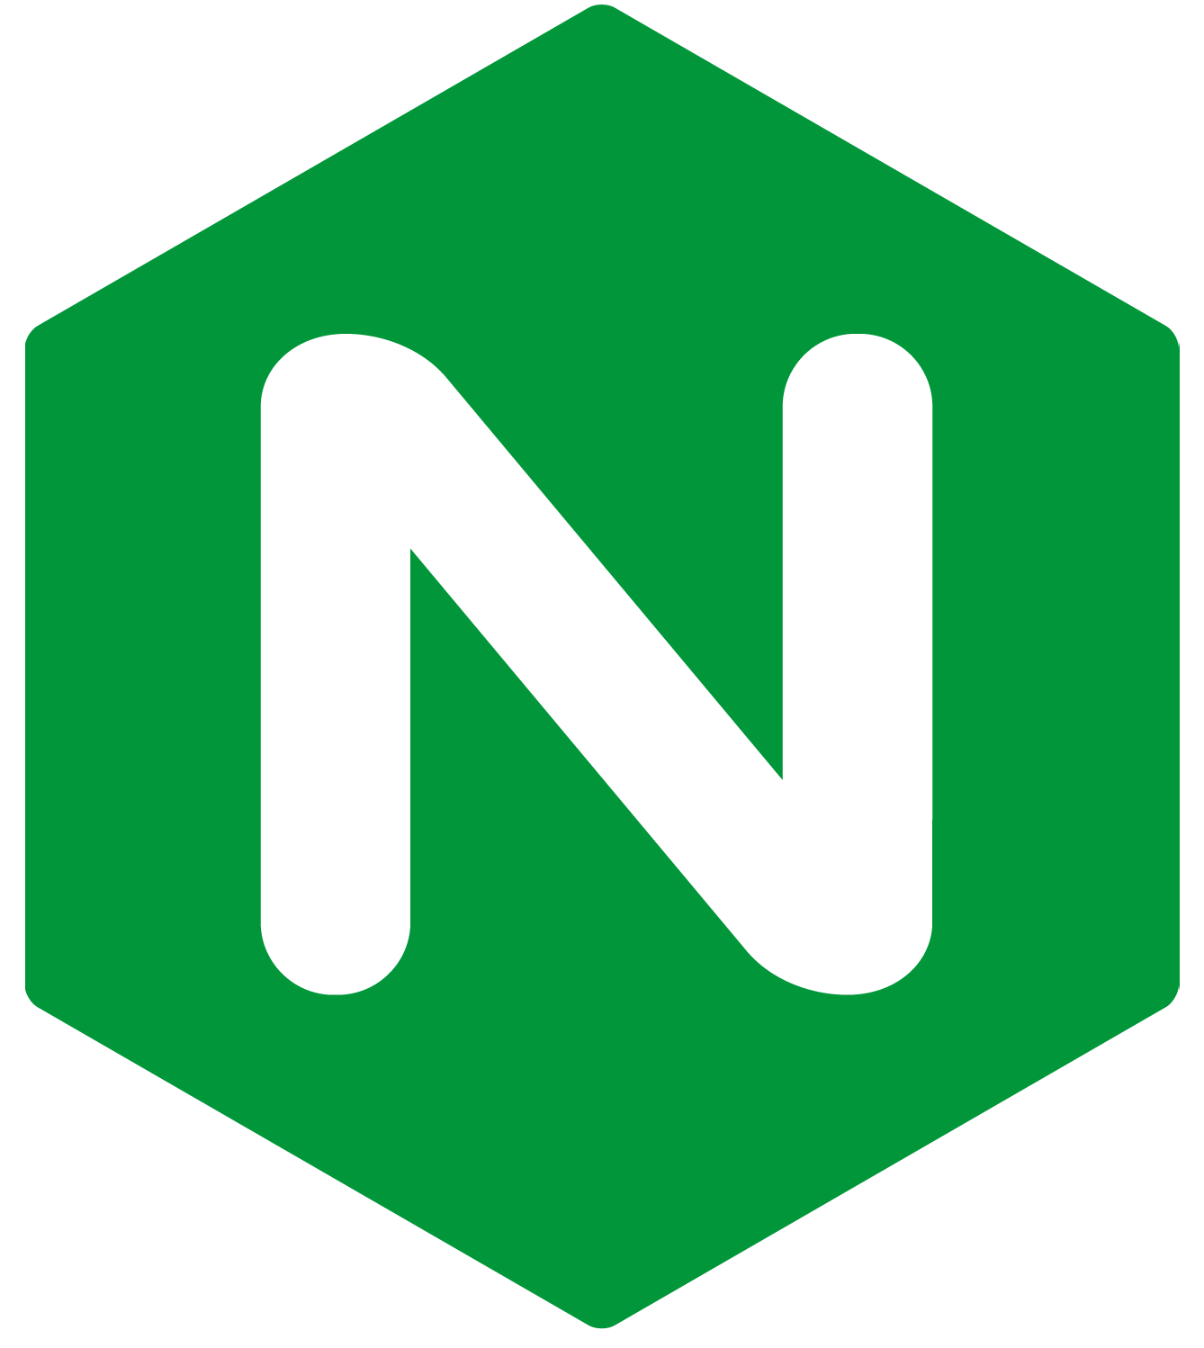
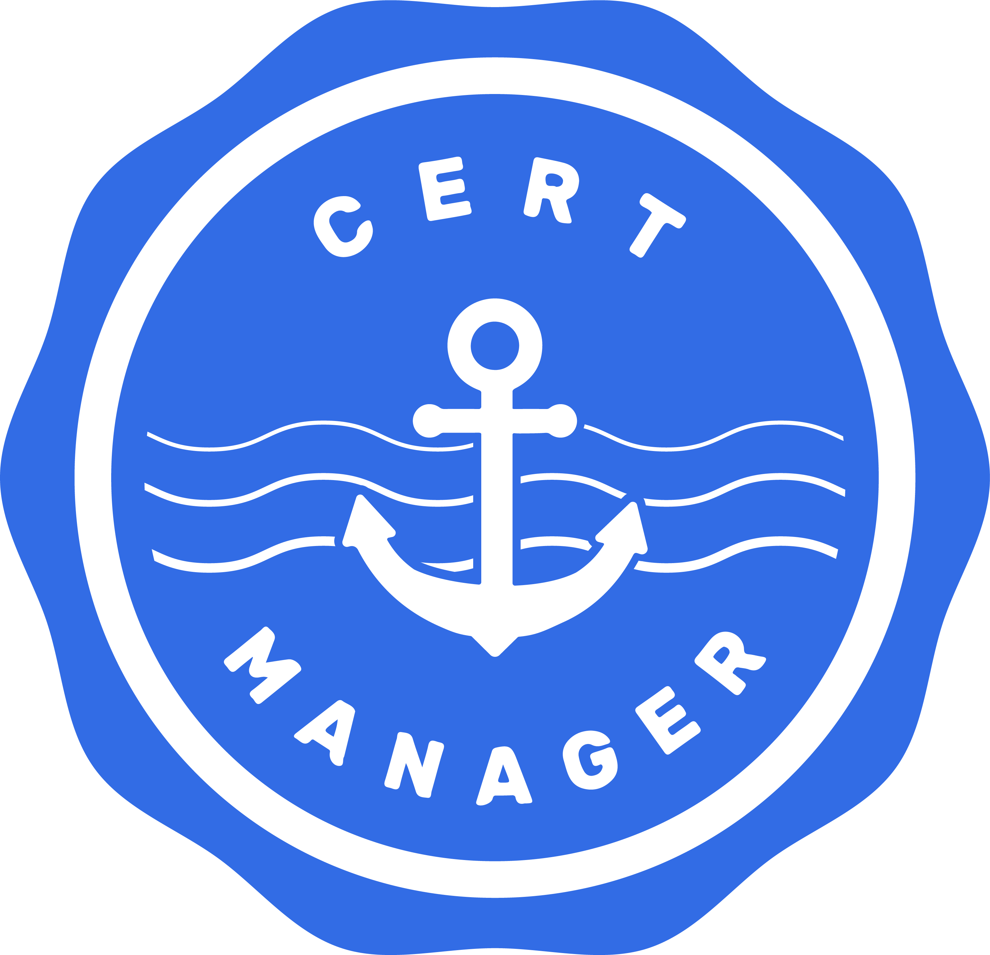
Nginx-Ingress & Cert-Manager
Nginx-Ingress is used as a reverse proxy into the cluster
Cert-Manager is used in combination
Automated SSL certificate generation
Automatic certificate renewal
Notes:
https://kubernetes.io/docs/concepts/services-networking/ingress/
https://github.com/kubernetes/ingress-nginx
https://github.com/jetstack/cert-manager

Slide 8
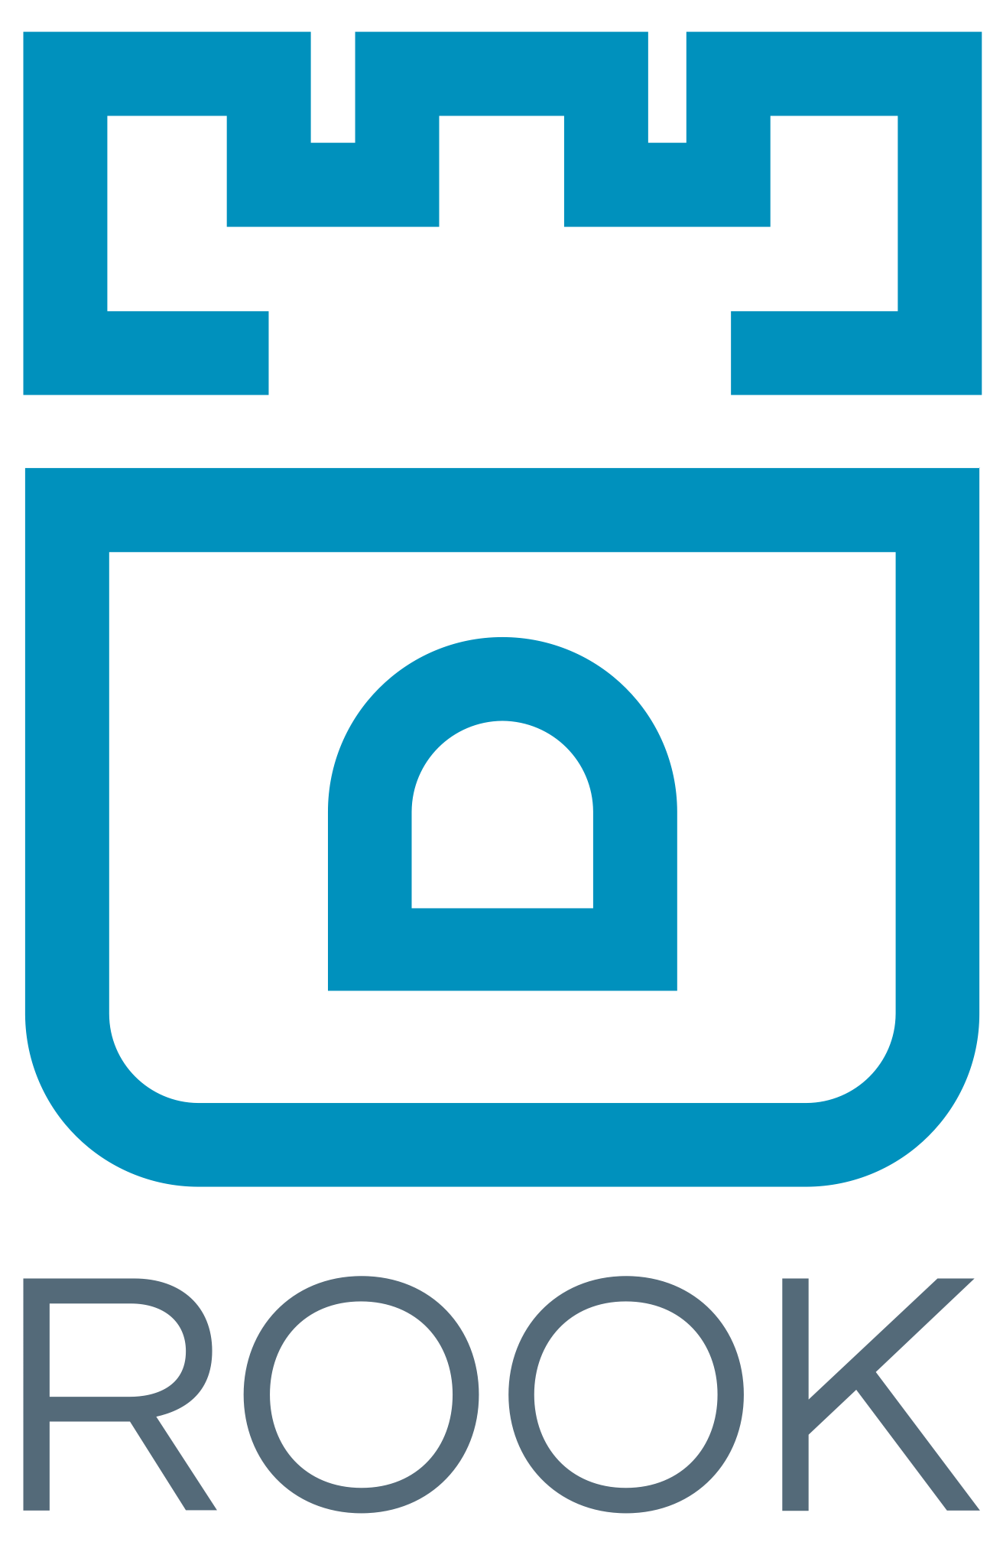
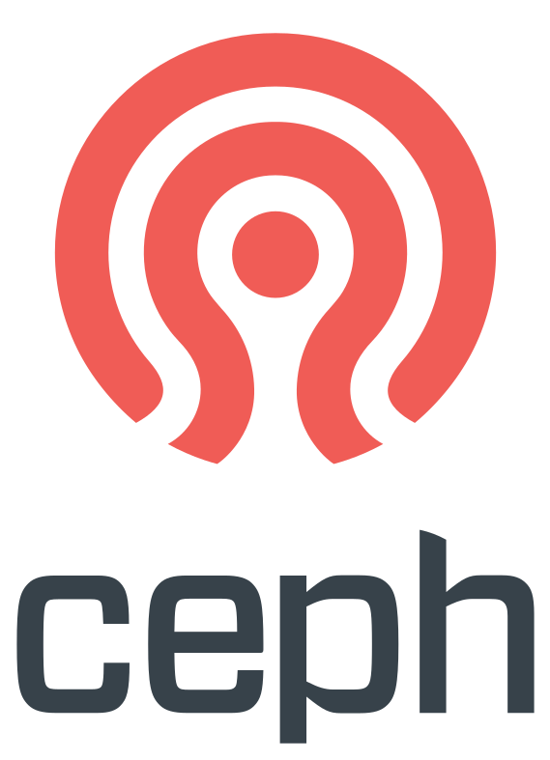
Rook-Ceph Storage Provider
The Rook operator provides a cloud-native way to deploy Ceph
Ceph provides resilient, distributed storage
Ceph shared filesystem was leveraged
Multiple NetBox instances sharing a single file storage
Allows for a distributed, highly-available NetBox service
Notes:
https://rook.io/
https://ceph.io/
https://kubernetes.io/docs/concepts/storage/volumes/

Slide 9
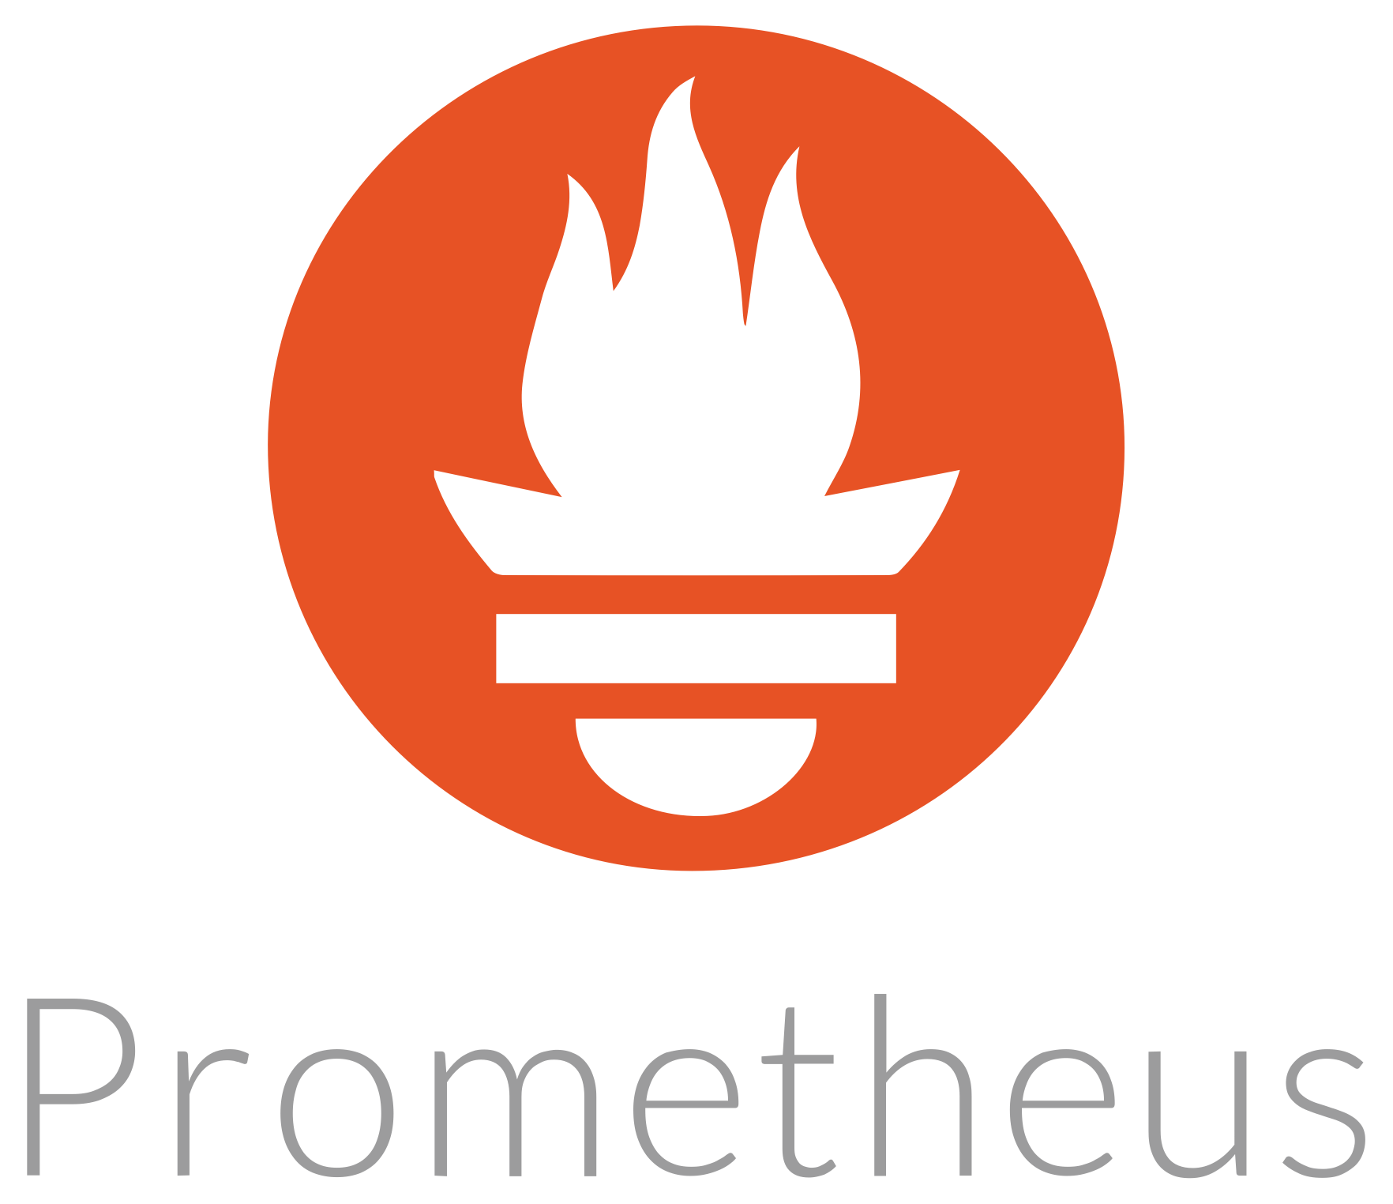
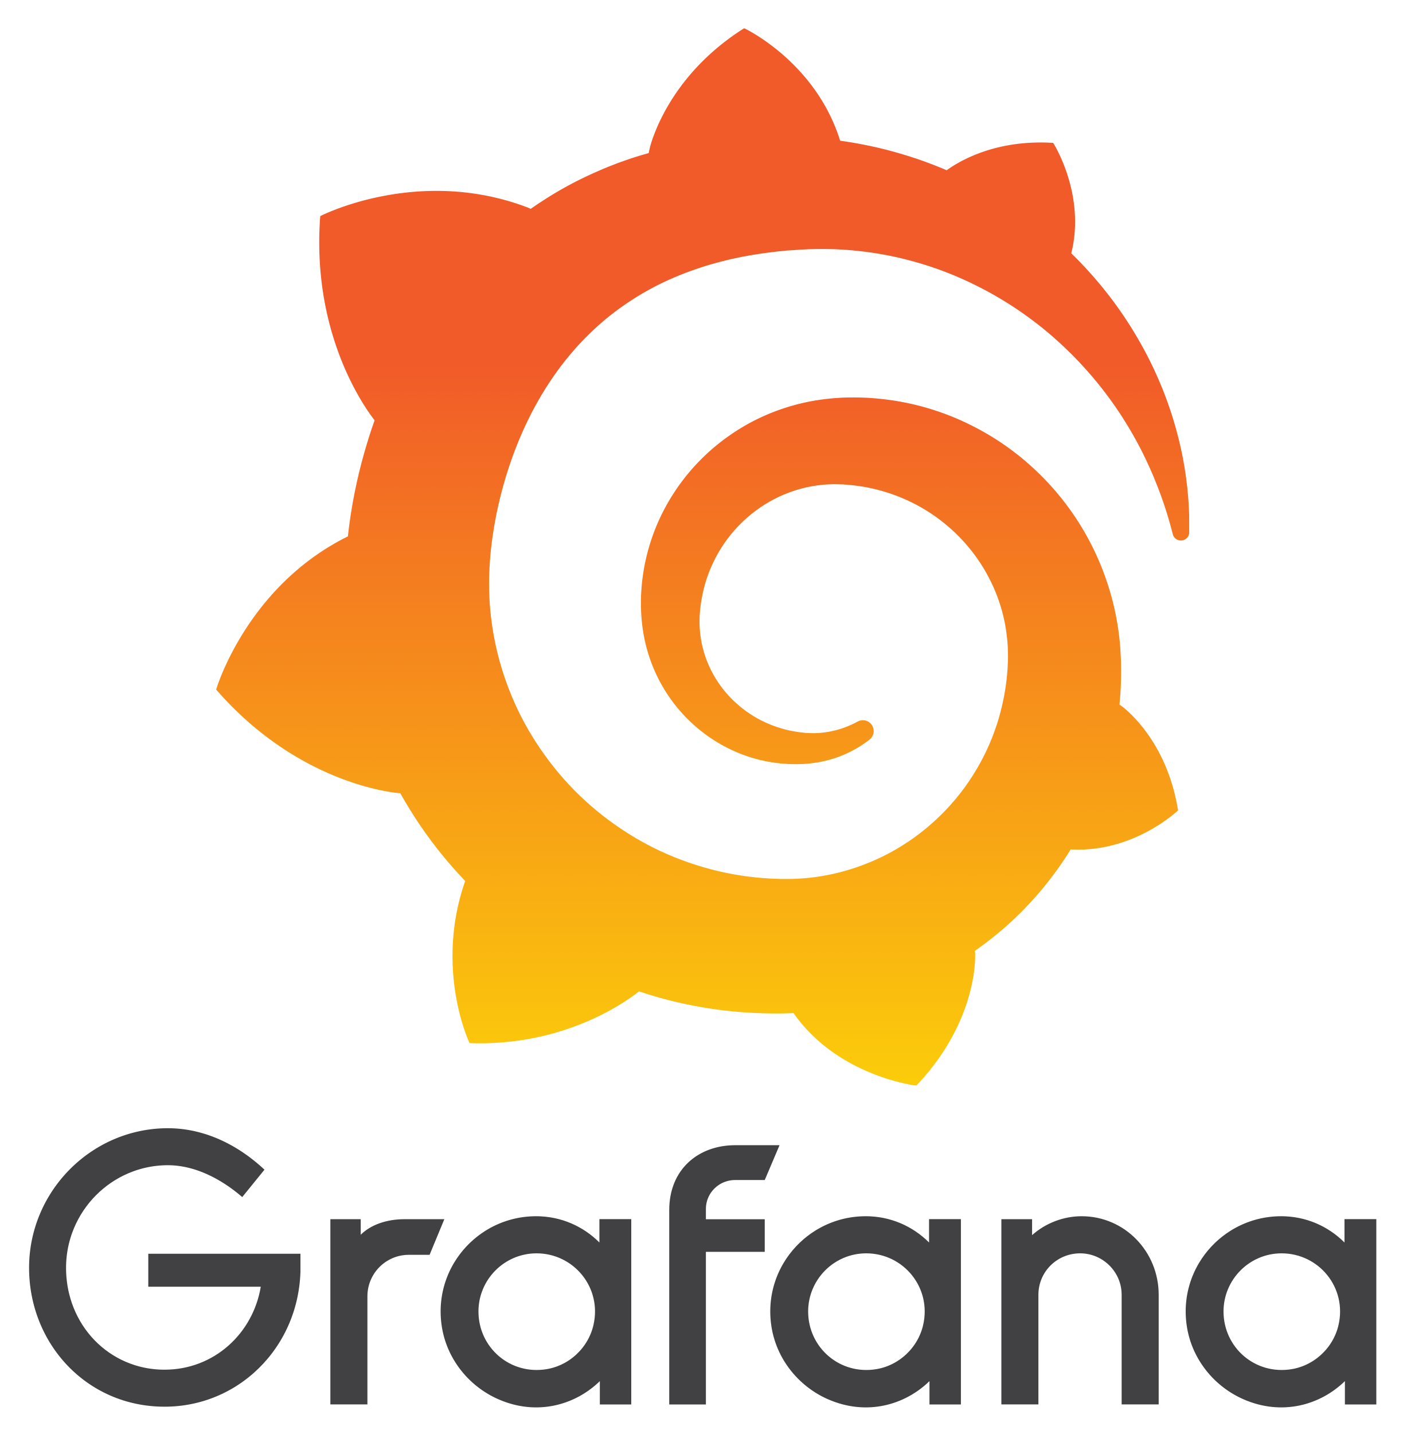
Built-In Monitoring
Various aspects of the service can be monitored and alerted on
NetBox service availability
Ingress traffic
Django metrics
Notes:
https://prometheus.io/
https://grafana.com/
https://github.com/coreos/kube-Prometheus
https://github.com/coreos/prometheus-operator

Slide 10
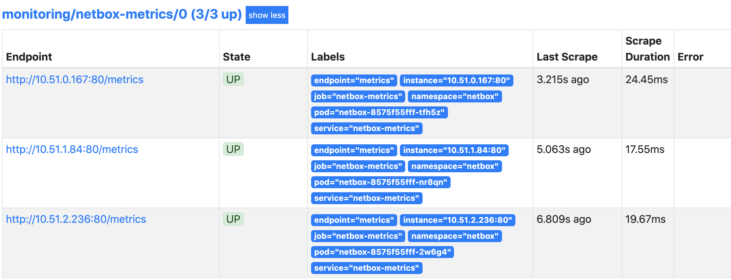
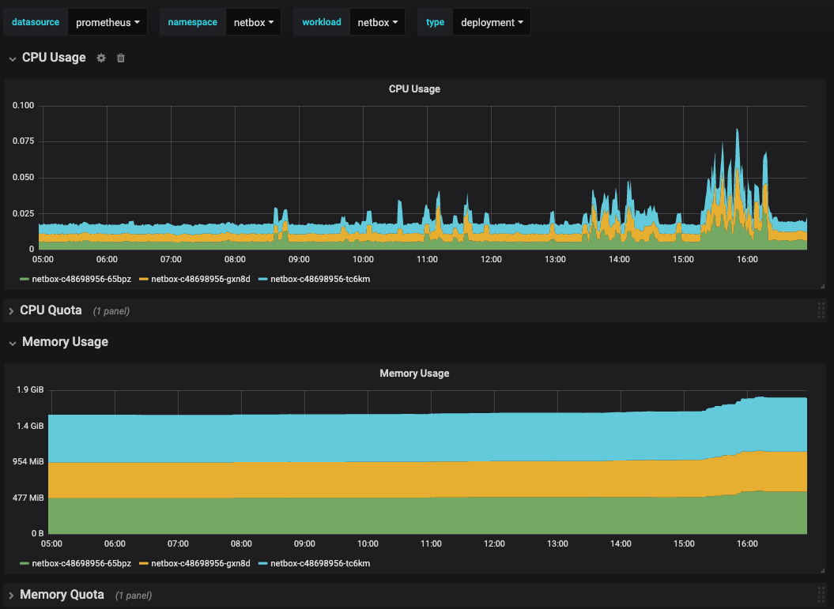
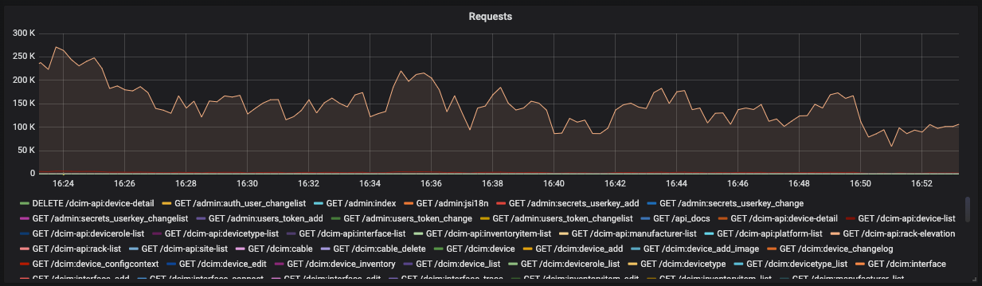
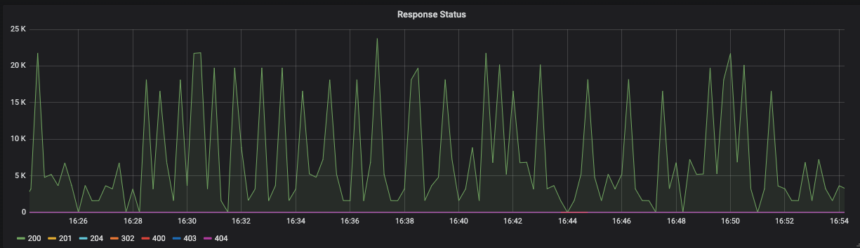
Dashboard Examples

Slide 11
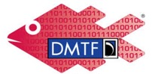
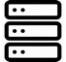
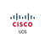

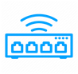
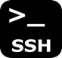
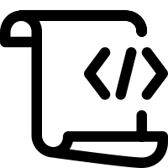

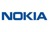

NetBox Automation
SERVERS
PyNetBox
REDFISH API
NETWORKING
DEVICES
PARAMIKO
Notes:
Initial population of NetBox required some level of automation to have valid inventory
APIs such as Redfish for our servers, and Paramiko for networking devices, were used to extract the information and send them to NetBox using PyNetBox
https://github.com/digitalocean/pynetbox
https://www.dmtf.org/standards/redfish
http://www.paramiko.org/

Slide 12
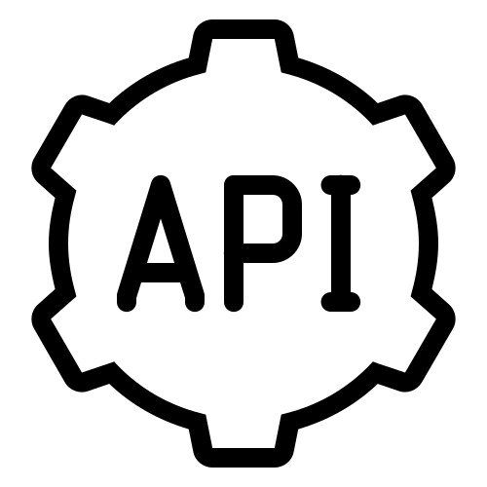
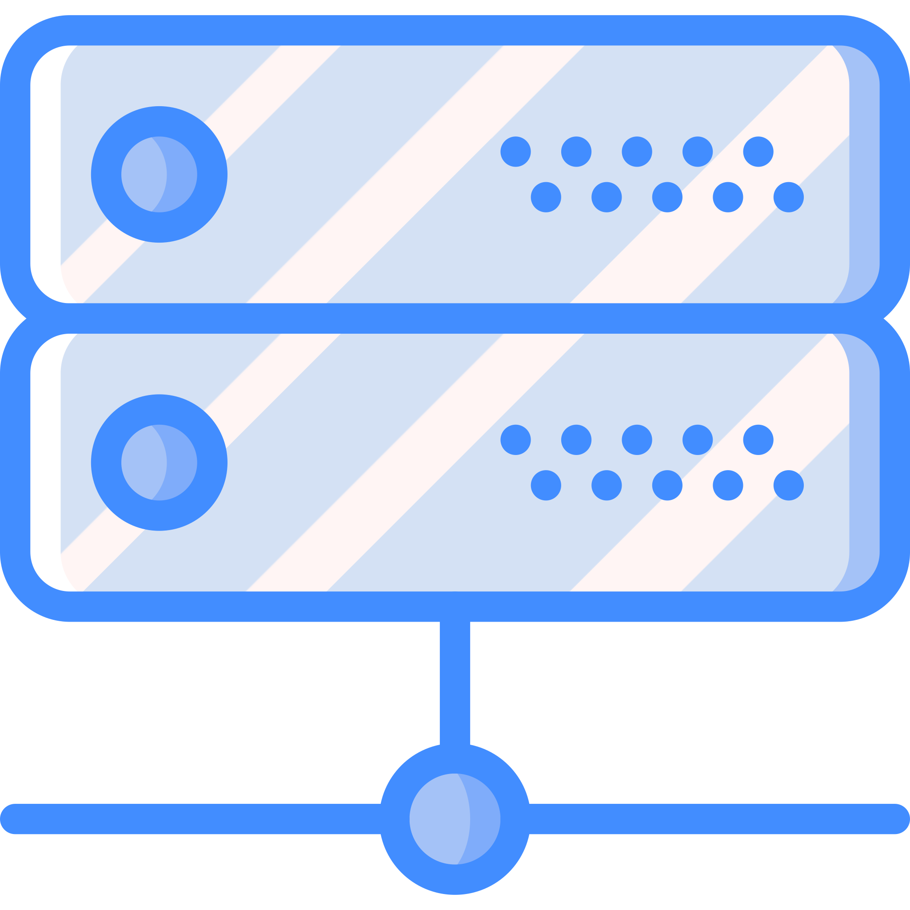

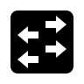
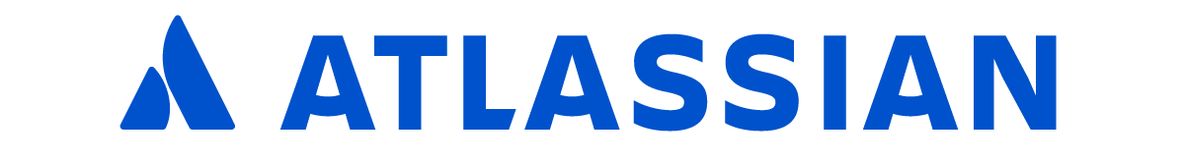
NetBox Automation
Notes:
Similarily, since NetBox is a source of truth, we use it to generate templates and networking configs for project provisioning
We also use the REST APIs to populate charts, capacity, and other types of dashboards within our collaboration tool stack (Jira, Confluence)

Slide 13


THANK YOU
Are you active in any Canadian innovative ICT solutions?
https://www.cengn.ca
@CENGNCanada
Sample manifests for a Kubernetes deployment:
https://github.com/CENGN/netbox-kubernetes
Notes:
If you or anyone you know is a Canadian business actively working on an innovative ICT solution, we would love to hear from you!
https://www.cengn.ca/
https://twitter.com/CENGNCanada

